Slide 1

MediMate: Medical Chatbot
Abdullah Maraş Ceyda Başoğlu Selin Çıldam Yunus Serhat Bıçakçı
18.05.2024

Slide 2
Today’s Agenda
About Us
Introduction and Problem Statement
Datasets and Models
Methodology
Results
Discussion
Conclusions
Teamwork Summary
What is Next
Questions

Slide 3
Team - Who are we?
Abdullah Maraş, PhD
Data Scientist @CCI
Ceyda Başoğlu
Computer Engineering B.Sc Student @Yaşar University, Project Assistant @Yaşar Bilgi.
Selin Çıldam
Data Scientist @Pazarama.
Yunus Serhat Bıçakçı, PhD
Researcher @UCL

Slide 4
Introduction and Problem Statement
The goal of this project is to develop a chatbot that can accurately understand and respond to patient queries.
Leveraging state-of-the-art large language models such as Mistral and LLama, our chatbot will utilise advanced natural language processing methods to effectively understand and respond to a wide variety of patient queries.
The chatbot will be primarily designed to work in Turkish language.

Slide 5
Literature Review
Vaswani A, Shazeer N, Parmar N, Uszkoreit J, Jones L, Gomez AN, Kaiser L, Polosukhin I. Attention Is All You Need. 2017. arXiv:1706.03762. https://arxiv.org/abs/1706.03762
Llama 2: Open Foundation and Fine-Tuned Chat Models.Submitted on 18 Jul 2023 (v1), last revised 19 Jul 2023 (this version, v2)] arXiv:2307.09288.https://arxiv.org/abs/2307.09288
https://arxiv.org/abs/2310.06825
S. S. Manathunga, Y. A. Illangasekara Retrieval Augmented Generation and Representative Vector Summarization for large unstructured textual data in Medical Education 2023. arXiv:2308.00479. https://arxiv.org/abs/2308.00479
Mistral 7B. 2023. arXiv:2310.06825. https://arxiv.org/abs/2310.06825
https://huggingface.co/spaces/HuggingFaceH4/open_llm_leaderboard
https://www.kaggle.com/models/google/gemma

Slide 6

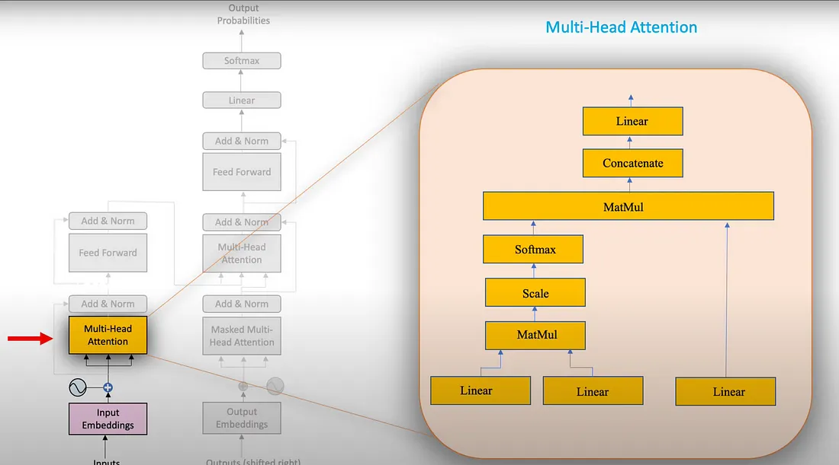
Literature Review
Vaswani, Ashish, et al. "Attention is all you need." Advances in neural information processing systems 30 (2017).
Notes:
Transformers Types:
Encoder Only Models:
Also called as Autoencoding Models. Objective is to preconstruct masked token (also called as denoising). This model is also called as MLM(Masked Language Modeling). This is bi-directional model (left to right and right to left training)
Good use cases: Sentiment Analysis, Word classifications, Named entity recognition,
Few Models in this family: BERT, ROBERTA
Encoder decoder Models:
Also called as Seq-to-seq models, uses encoder and decoder of transformer. It works on span corruption. Randomly masks token and masked tokens are combined/sentinel token.
Good use cases: Translation, Text summarization, Q&A
Few models in this family: T5 and BART etc.
Decoder Only Models:
Also called Autoregressive models. Pretrained using Causal Language Modelling (CLM). Objective is to predict next token based on previous sequence of tokens. This is unidirectional
Good use cases: Text gener
ation, Good with zero shot and single shot inferences,
Few models in this family: GPT

Slide 7
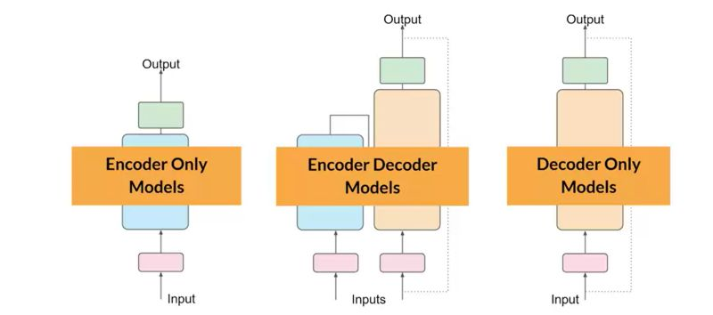
Literature Review
Notes:
Transformers Types:
Encoder Only Models:
Also called as Autoencoding Models. Objective is to preconstruct masked token (also called as denoising). This model is also called as MLM(Masked Language Modeling). This is bi-directional model (left to right and right to left training)
Good use cases: Sentiment Analysis, Word classifications, Named entity recognition,
Few Models in this family: BERT, ROBERTA
Encoder decoder Models:
Also called as Seq-to-seq models, uses encoder and decoder of transformer. It works on span corruption. Randomly masks token and masked tokens are combined/sentinel token.
Good use cases: Translation, Text summarization, Q&A
Few models in this family: T5 and BART etc.
Decoder Only Models:
Also called Autoregressive models. Pretrained using Causal Language Modelling (CLM). Objective is to predict next token based on previous sequence of tokens. This is unidirectional
Good use cases: Text generation, Good with zero shot and single shot inferences,
Few models in this family: GPT

Slide 8
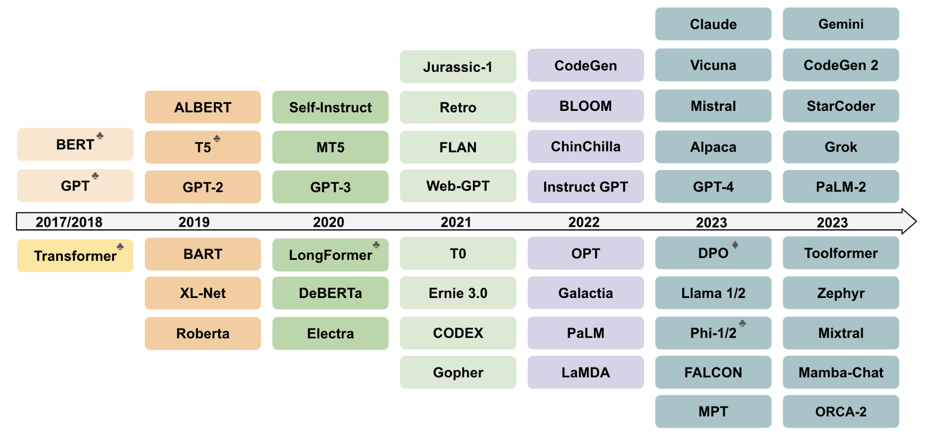
Literature Review
Notes:
Timeline of some of the most representative LLM frameworks

Slide 9
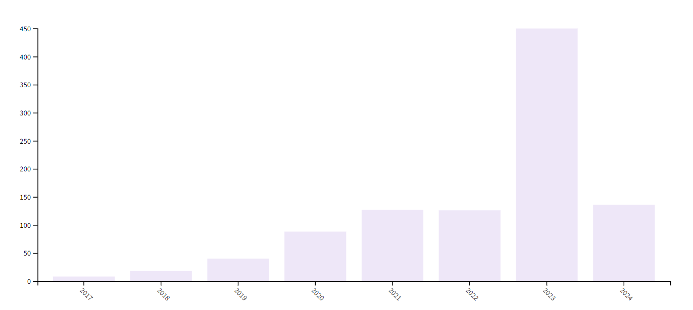
Literature Review
Yearly Medical Chatbot Interest

Slide 10
Project Steps
Data Preparation and Datasets
Choosing the right pre-trained model
Identifying the right parameters for fine-tuning
Model deployment (Future)
The process of finding data sets and making the data sets ready
Selection phase of the correct pre-trained model
Selecting the configs and parameters to be fine-tuned
Taking the model live and making it ready
1
2
3
4

Slide 11
Datasets for Fine-Tuning
iCliniq,13k,Turkish
Medquad,16k,English

Slide 12
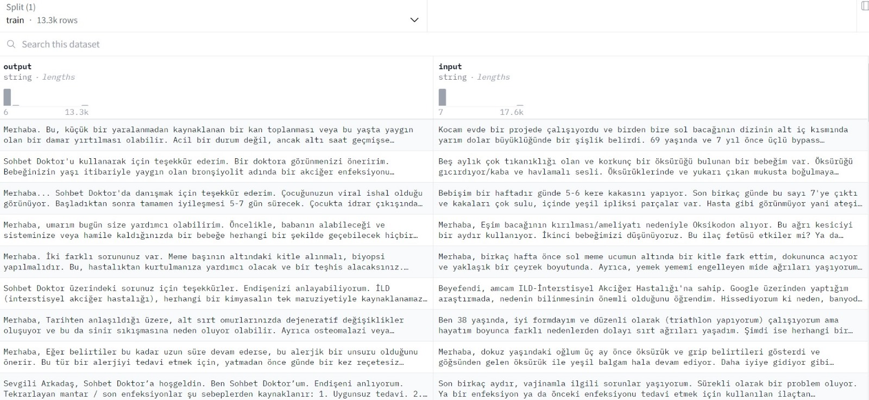
Datasets Samples (iCliniq,13k,Turkish)
Yagnik, N., Jhaveri, J., Sharma, V., Pila, G., Ben, A., & Shang, J. (2024). MedLM: Exploring Language Models for Medical Question Answering Systems. arXiv preprint arXiv:2401.11389.

Slide 13
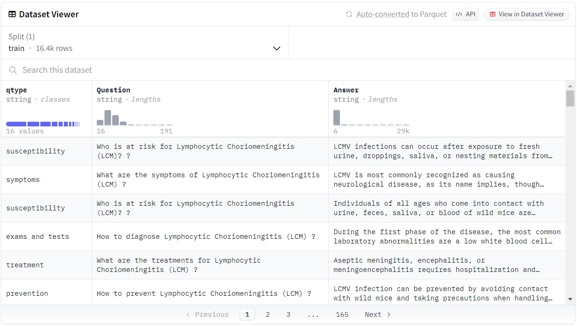
Datasets Samples (Medquad,16k,English)
Ben Abacha, A., & Demner-Fushman, D. (2019). A question-entailment approach to question answering. BMC bioinformatics, 20, 1-23.

Slide 14
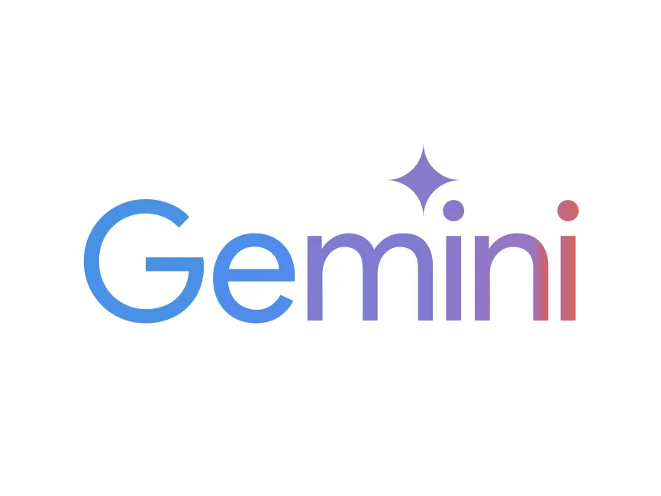
Data Preparation
Medquad datasets was converted to Turkish by using the Google Translate Api.
Also Gemini api experienced for translation

Slide 15
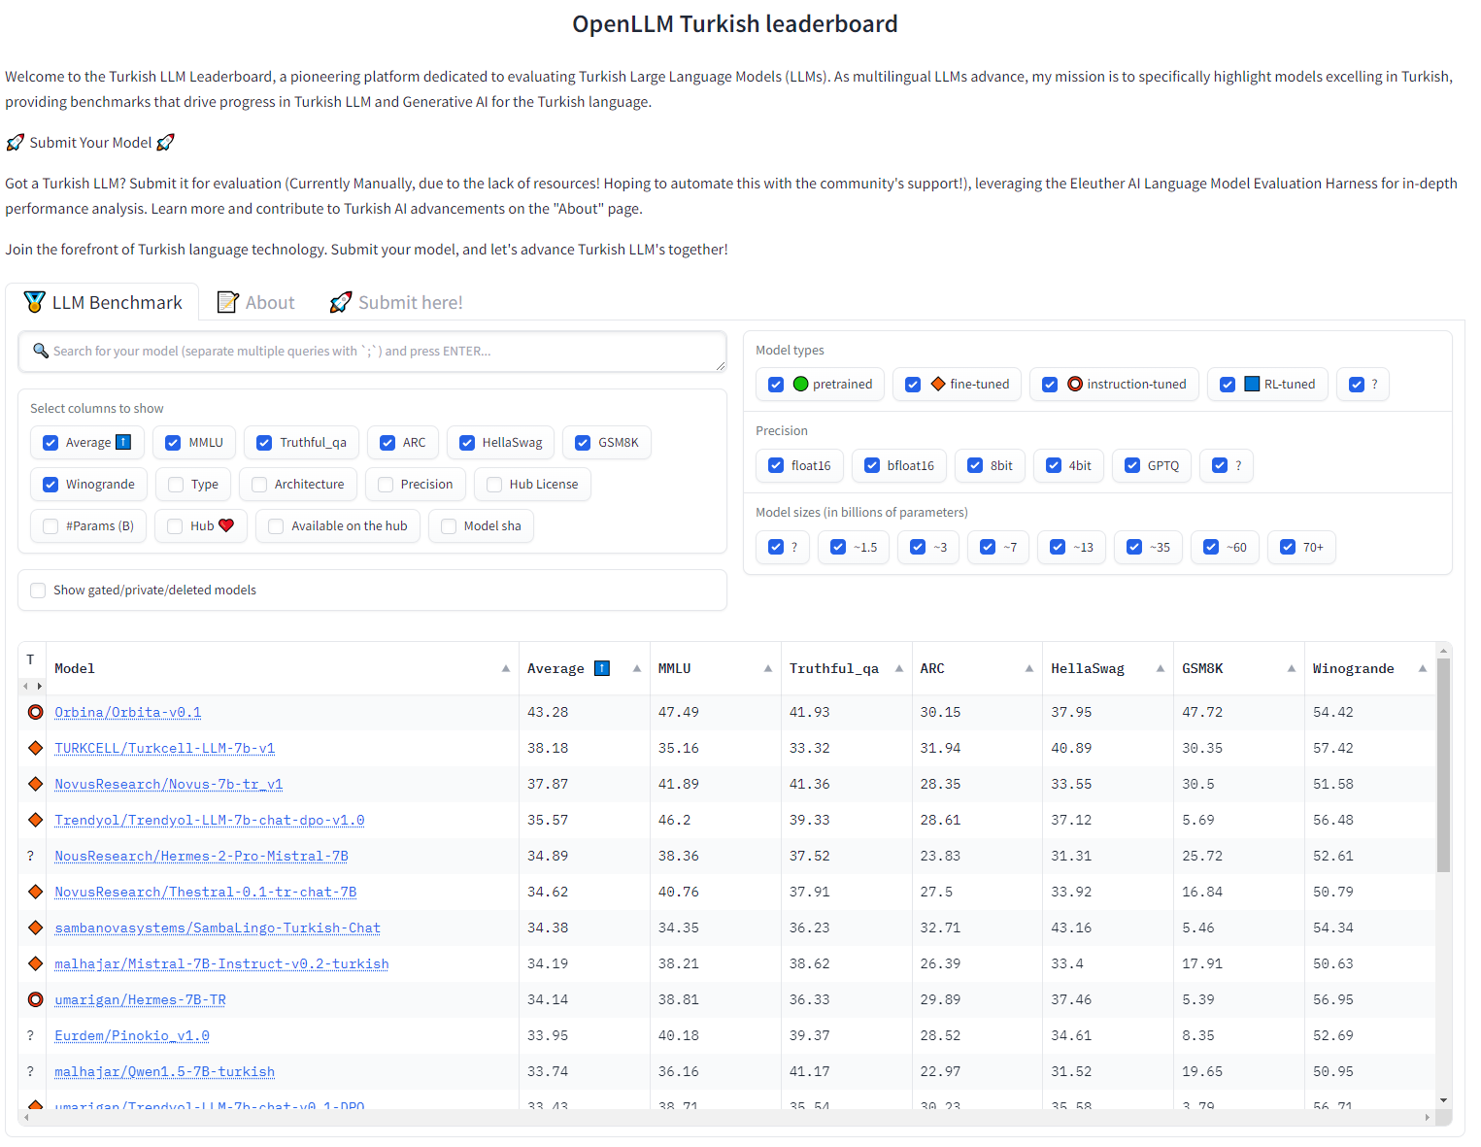
Choosing the right pre-trained model

Slide 16
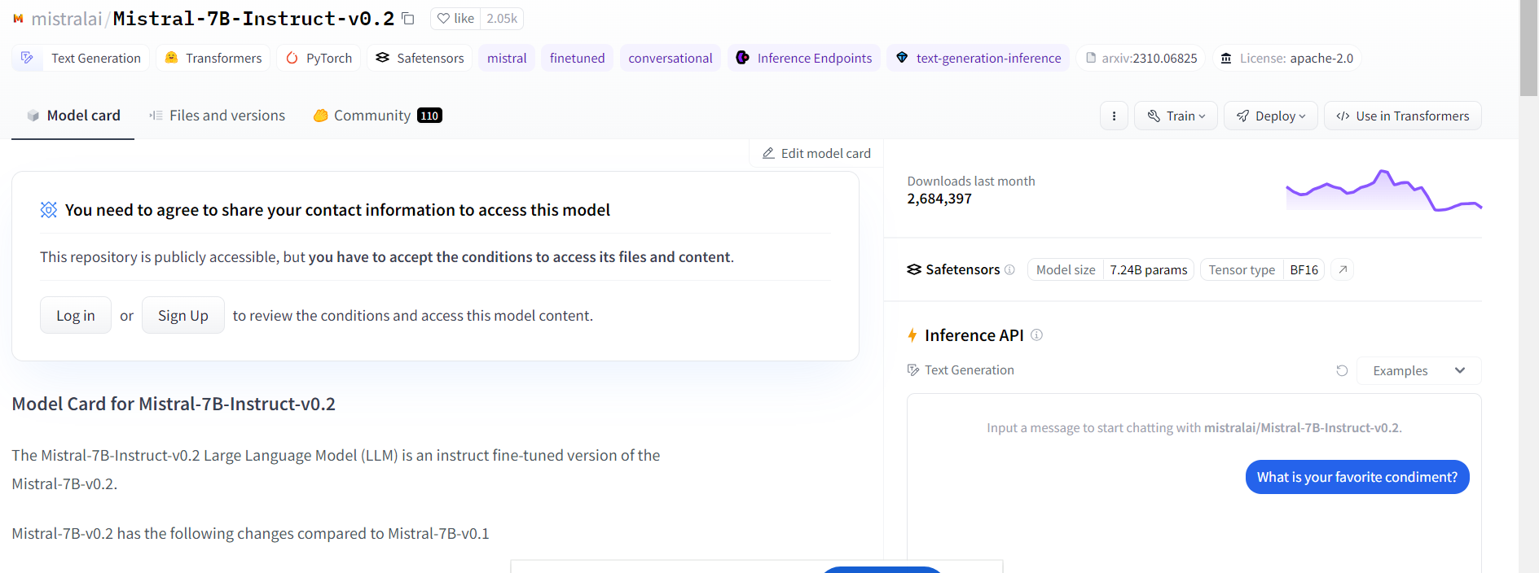
Pre-trained Models

Slide 17
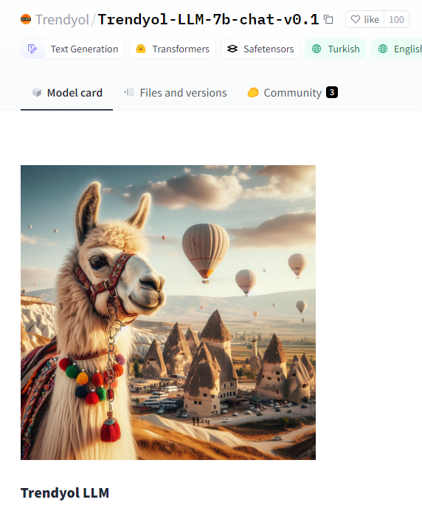
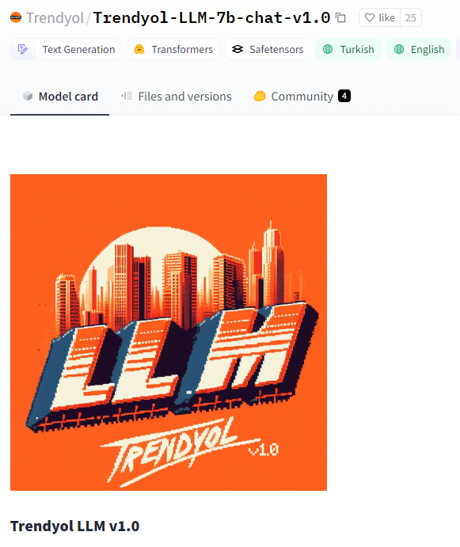
Pre-trained Models

Slide 18
Metodology - Fine - tuning
Fine-tuning is the process of customising a pre-trained deep learning model by retraining it on a specific task or dataset. This process enables the model to adapt its general knowledge to new data and tasks.
Fine-tuning improves model performance on customised tasks and offers a cost-effective solution.
However, fine-tuning requires extensive knowledge of model architecture, benchmark performance and adaptability

Slide 19
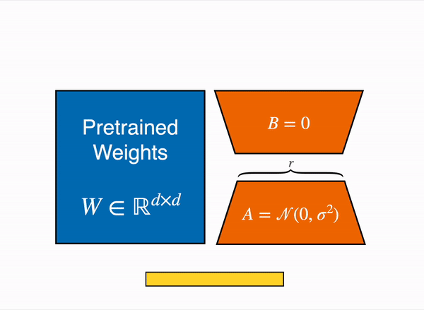
Parameter Efficient Fine-tuning (LoRA)
1. Parameter Reduction
2. Efficient GPU Memory Usage
3. Avoiding Overfitting
4. Efficient Task-Switching
LoRA: Low-Rank Adaptation of Large Language Models

Slide 20
Challanges
GPU Resource Limitations:
Impact: The lack of sufficient GPU resources prevented us from effectively fine-tuning our models. Fine-tuning large language models requires substantial computational power, which was not fully available.
Consequence: This limitation constrained our ability to improve the model's performance and adapt it to our specific needs.

Slide 21
Challenges-2
Token Limits in Translation Models:
Impact: When translating our English datasets to Turkish using large language models (LLMs), we encountered token limitations. These models have a maximum token limit they can process at a time, which hindered our ability to translate large datasets efficiently.
Consequence: This issue led to incomplete translations and inconsistencies within the dataset, affecting the overall quality and performance of our chatbot in the Turkish language.

Slide 22
Experimental Results

Slide 23
Discussion
In recent years, there has been substantial progress in developing medical chatbots leveraging large language models (LLMs). Notable projects such as ChatDoctor, MedLM, and the integration of models like Llama and Mistral have set high benchmarks in terms of performance and capabilities​​. These chatbots primarily focused on providing accurate medical information, assisting in diagnostics, and enhancing patient engagement by understanding and responding to a wide range of medical queries in English.
Our project, MediMate, distinguishes itself by targeting the Turkish language, addressing a significant gap in the availability of medical conversational AI in non-English languages. While previous works have showcased impressive results in English, there has been limited progress in adapting these models for Turkish, which presents unique linguistic challenges. This adaptation is critical to improving healthcare accessibility for Turkish-speaking populations.

Slide 24
Strengths of Our Approach
Language Adaptation: One of the most notable strengths of MediMate is its focus on the Turkish language. By utilizing advanced translation techniques and fine-tuning strategies, we have tailored the model to understand and respond to medical queries in Turkish effectively. This localization ensures that the chatbot is not just a direct translation of English models but is adapted to the nuances of the Turkish language and medical terminology.

Slide 25
Conclusion
The challenges encountered in this project, including GPU resource limitations and token constraints in translation models, were significant. However, they provided critical insights into the complexities of developing sophisticated AI systems. By understanding and addressing these challenges, we can better prepare for future projects, ensuring more robust and efficient development processes. This experience has reinforced the importance of thorough planning, resource management, and continuous learning in the field of AI.

Slide 26
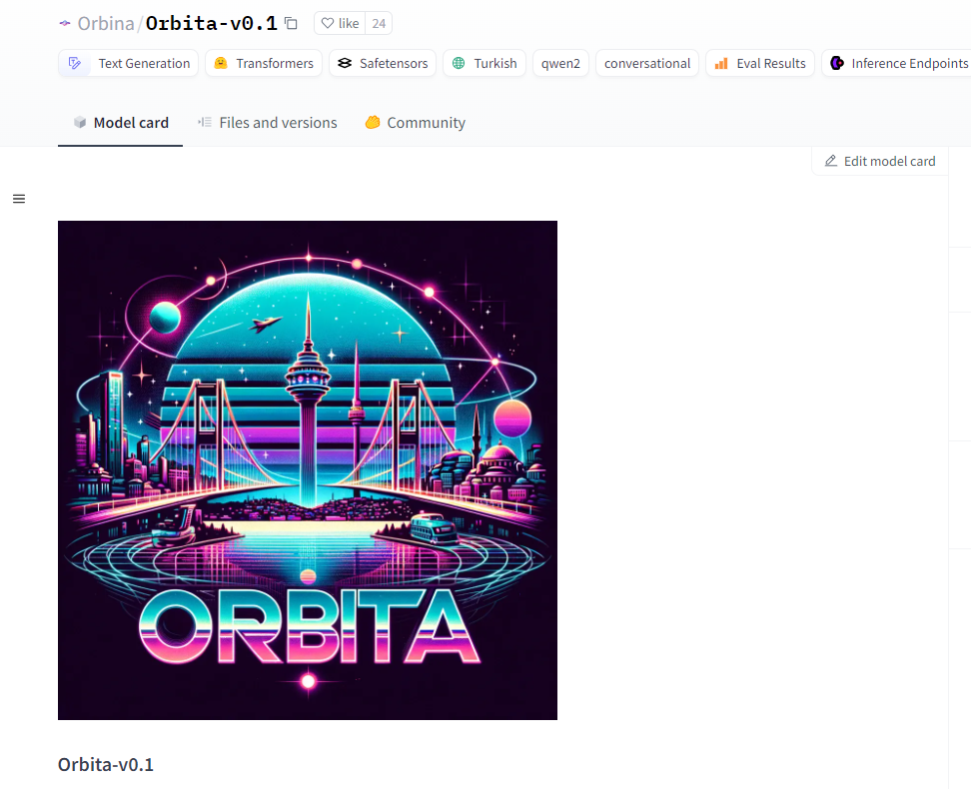
What is Next?

Slide 27
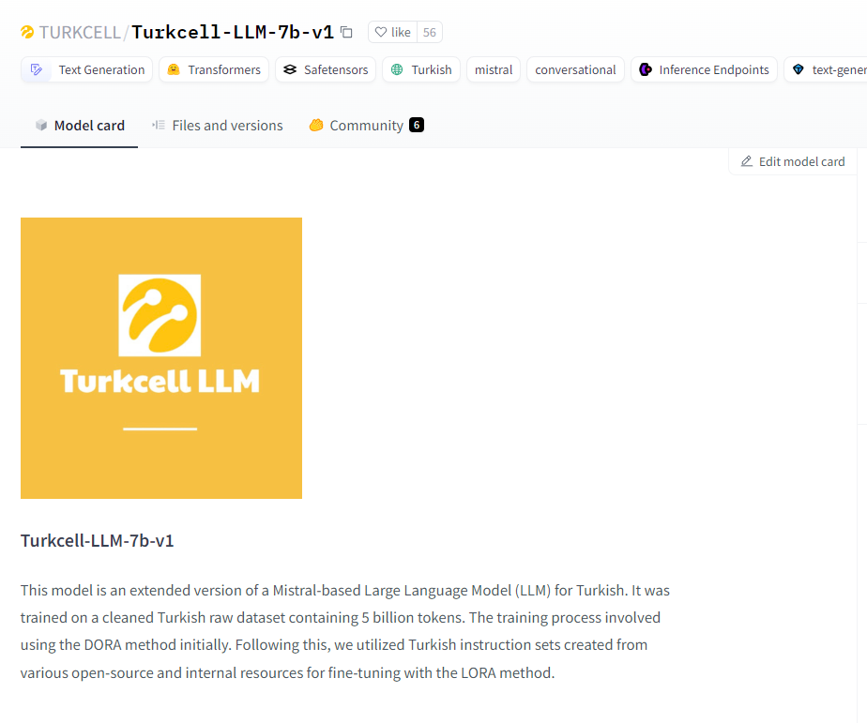
What is Next?

Slide 28
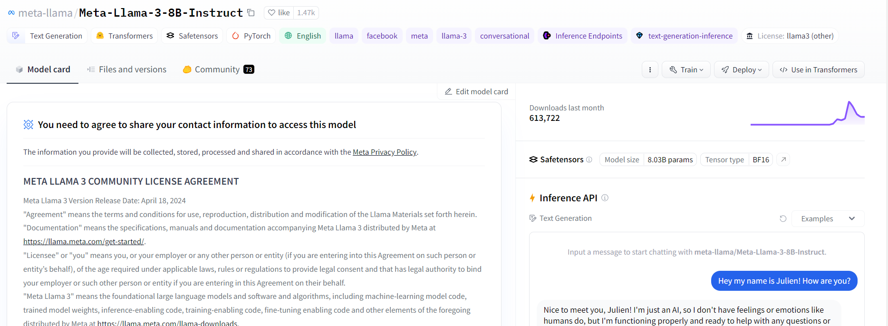
What is Next?

Slide 29
What is Next?
The Chatdoctor dataset will be translated into Turkish and the model will be fine tuned with a larger dataset.
RAG models will be tried with the fine tuned model
The model will be deployed and model inferences will be taken live

Slide 30
References
Vaswani A, Shazeer N, Parmar N, Uszkoreit J, Jones L, Gomez AN, Kaiser L, Polosukhin I. Attention Is All You Need. 2017. arXiv:1706.03762. https://arxiv.org/abs/1706.03762
Introducing Meta Llama 3: The most capable openly available LLM to date. 2024. https://llama.meta.com/llama3/
Mistral 7B. 2023. arXiv:2310.06825. https://arxiv.org/abs/2310.06825
https://huggingface.co/spaces/malhajar/OpenLLMTurkishLeaderboard
https://www.kaggle.com/models/google/gemma
Hu, Edward J., et al. "Lora: Low-rank adaptation of large language models." arXiv preprint arXiv:2106.09685 (2021).

Slide 31
Thank you! Questions?
For contact and further questions:
Abdullah Maraş
Ceyda Başoğlu
Selin Çıldam
Yunus Serhat Bıçakçı

